Slide 1
DETERMINISTIC EPIDEMIC MODELLING
HIV/AIDS
Name - Deepmalya Dutta
Roll – 0034
Supervisor - Prof. DIPTIMAN SAHA
Email – deepmalaya@gmail.com

Slide 2
Introduction
The spread of infectious diseases has always been of concerns and a threat to public health. It has caused serious problems for the survival of human beings and other species, and for the economic and social development of the human society. To prevent and to control infectious diseases more effectively, it is important to first fully understand the mechanism of the spread and the transmission dynamics of the diseases, and then provide useful predictions and guidance so that better strategies can be established.
The major areas of epidemic modelling include disease causation, transmission, outbreak, investigation, disease surveillance, screening, biomonitoring, and comparisons of treatment effects such as in clinical trials. They can also be categorized, based on the described diseases, populations, and environments.
In this paper, I’ve done detailed discussion on HIV/AIDS with mathematical simulations.

Slide 3
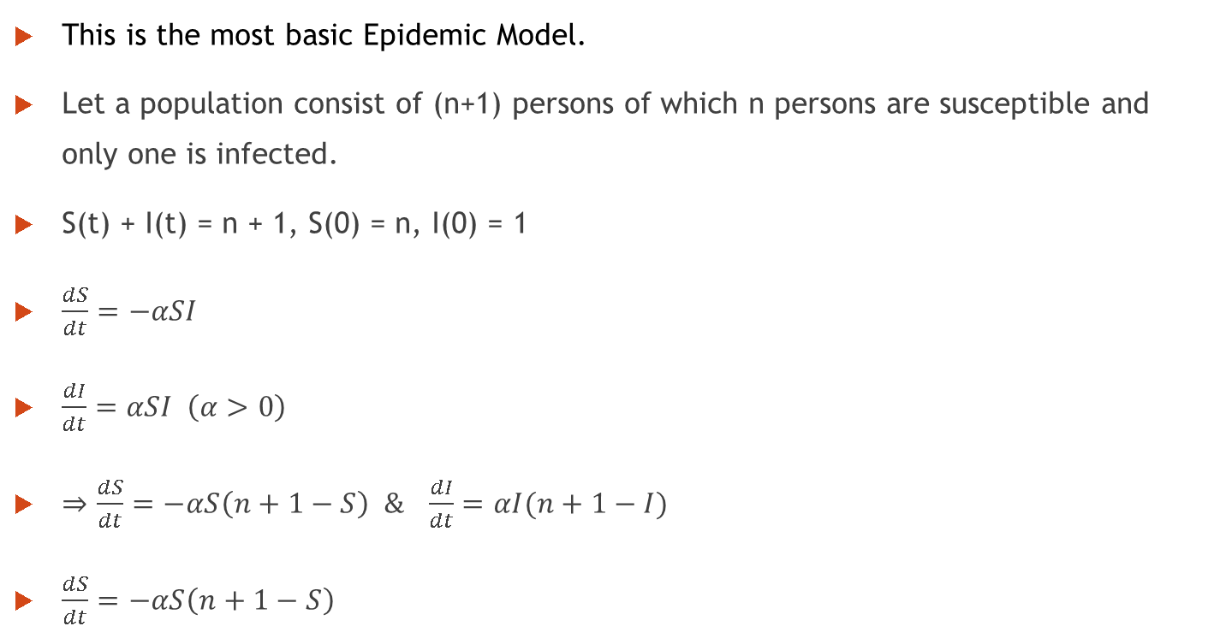
Susceptible Infective Model
This is the most basic Epidemic Model.
Let a population consist of (n+1) persons of which n persons are susceptible and only one is infected.
S(t) + I(t) = n + 1, S(0) = n, I(0) = 1
$\frac{dS}{dt}=−αSI$
$\frac{dI}{dt}=αSI \left(α>0\right)$
$⇒\frac{dS}{dt}=−αS\left(n+1−S\right) \& \frac{dI}{dt}=αI(n+1−I)$
$\frac{dS}{dt}=−αS\left(n+1−S\right)$

Slide 4

$S\left(t\right)=\frac{n(n+1)}{n+e^{\left(n+1\right)αt}} \& I\left(t\right)=\frac{(n+1)}{1+ne^{−\left(n+1\right)αt}}$
As $t → ∞ , S\left(t\right)→ 0 and I\left(t\right)→n+1$
We conclude that as time increases, all the susceptible persons will become infected.

Slide 5
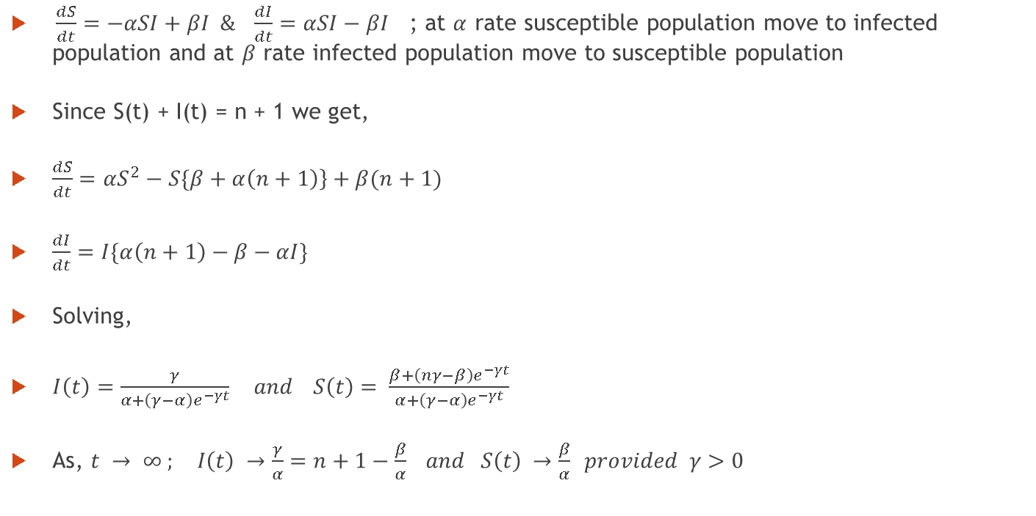
Susceptible Infective Susceptible Model
$\frac{dS}{dt}=−αSI+βI \& \frac{dI}{dt}=αSI−βI$ ; at $α$ rate susceptible population move to infected population and at $β$ rate infected population move to susceptible population
Since S(t) + I(t) = n + 1 we get,
$\frac{dS}{dt}={αS}^{2}−S\{\left.β+α\left(n+1\right)\right\}+β(n+1)$
$\frac{dI}{dt}=I\{α\left(n+1\right)−β−αI\}$
Solving,
$I\left(t\right)=\frac{γ}{α+\left(γ−α\right)e^{−γt}} and S\left(t\right)= \frac{β+\left(nγ−β\right)e^{−γt}}{α+\left(γ−α\right)e^{−γt}}$
As, $t → ∞ ; I\left(t\right) →\frac{γ}{α}=n+1−\frac{β}{α} and S\left(t\right) →\frac{β}{α} provided γ>0$

Slide 6
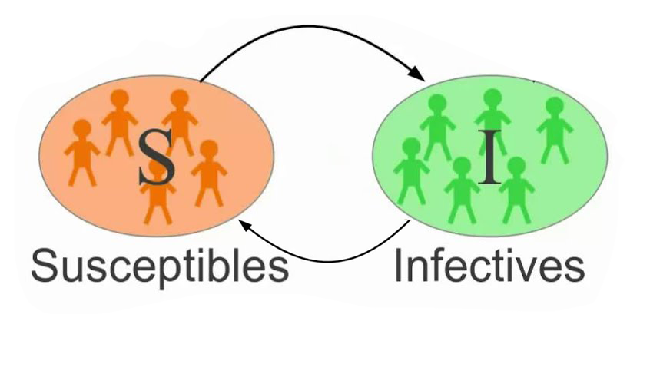

Slide 7
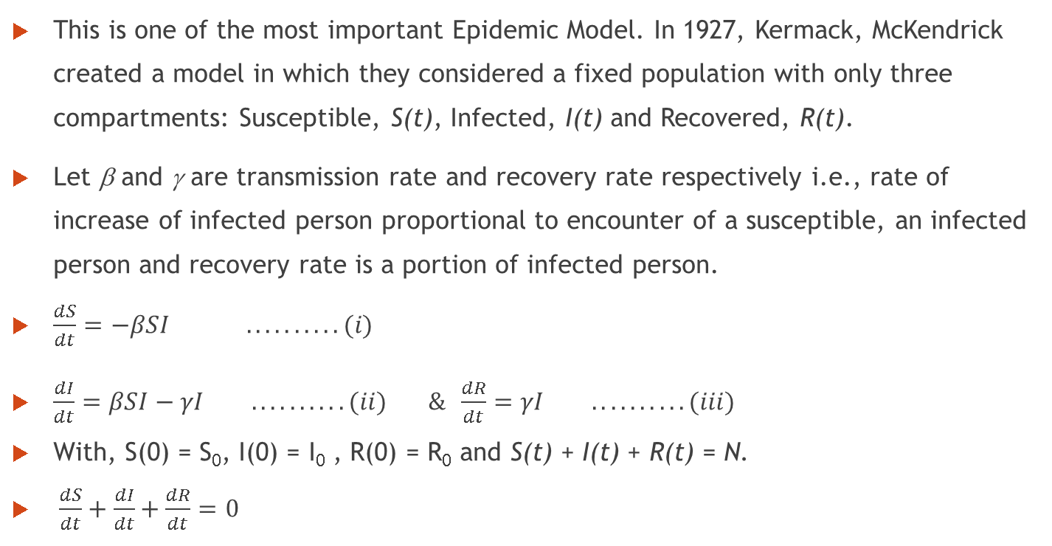
SIR Model
This is one of the most important Epidemic Model. In 1927, Kermack, McKendrick created a model in which they considered a fixed population with only three compartments: Susceptible, S(t), Infected, I(t) and Recovered, R(t).
Let β and γ are transmission rate and recovery rate respectively i.e., rate of increase of infected person proportional to encounter of a susceptible, an infected person and recovery rate is a portion of infected person.
$\frac{dS}{dt}=−βSI ..........(i)$
$\frac{dI}{dt}=βSI−γI ..........(ii) \& \frac{dR}{dt}=γI ..........(iii)$
With, S(0) = S₀, I(0) = I₀ , R(0) = R₀ and S(t) + I(t) + R(t) = N.
$\frac{dS}{dt}+\frac{dI}{dt}+\frac{dR}{dt}=0$

Slide 8
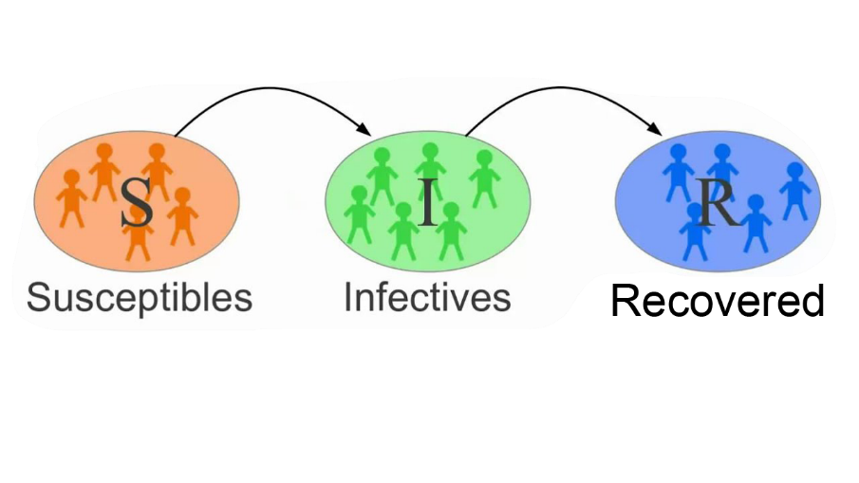

Slide 9
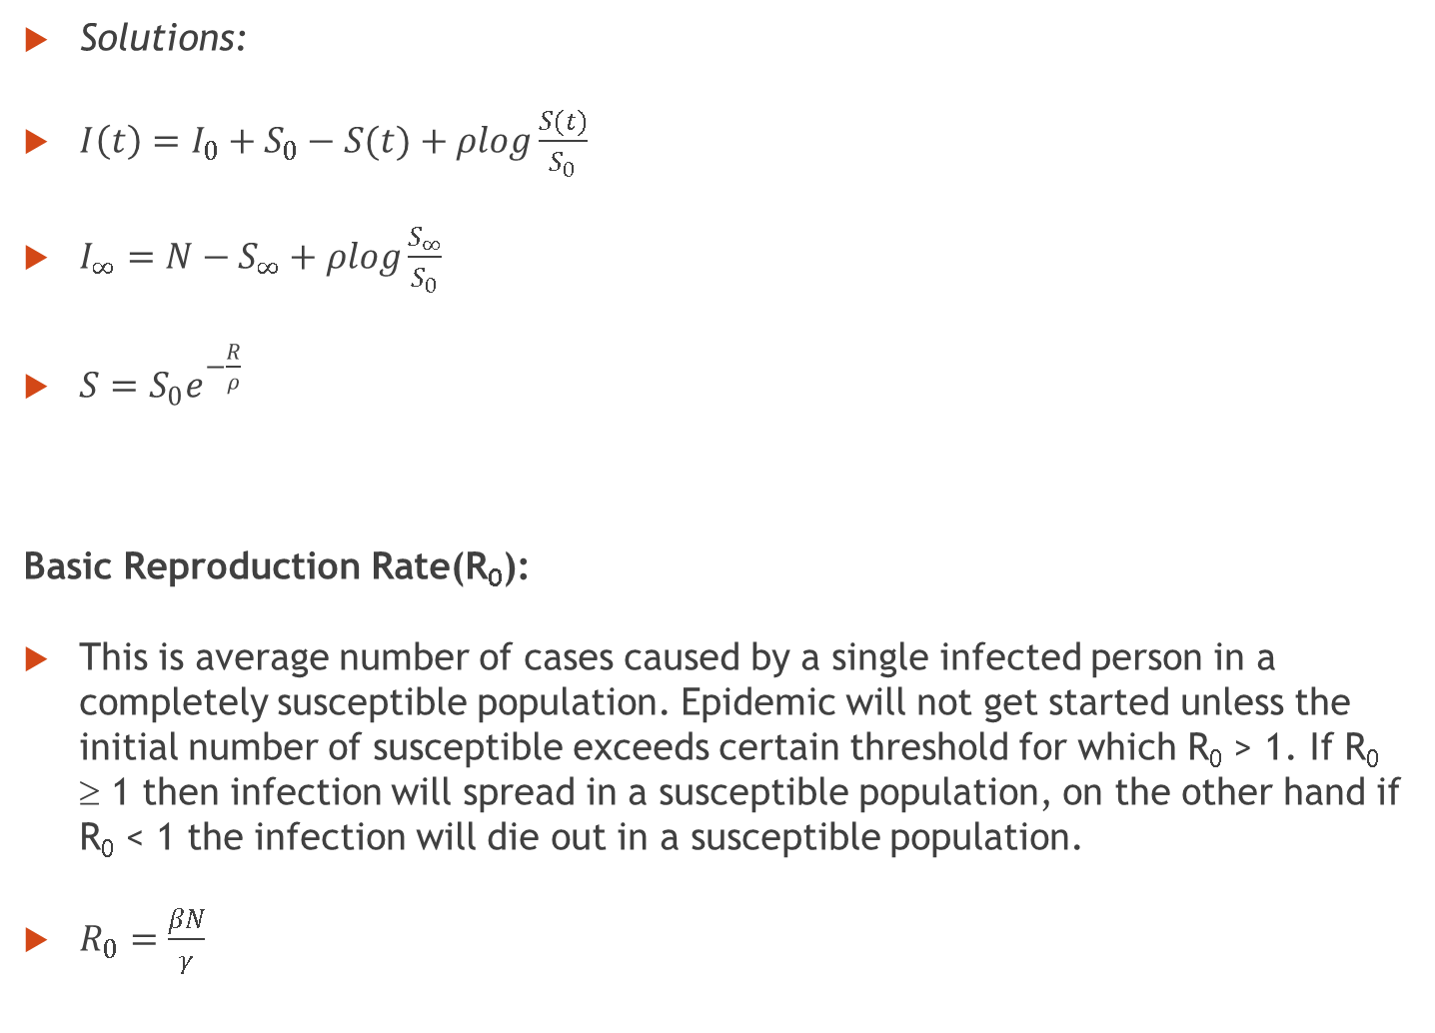
Solutions:
$I\left(t\right)=I_{0}+S_{0}−S(t)+ρlog\frac{S(t)}{S_{0}}$
$I_{∞}=N−S_{∞}+ρlog\frac{S_{∞}}{S_{0}}$
$S=S_{0}e^{−\frac{R}{ρ}}$
Basic Reproduction Rate(R₀):
This is average number of cases caused by a single infected person in a completely susceptible population. Epidemic will not get started unless the initial number of susceptible exceeds certain threshold for which R₀ > 1. If R₀ ≥ 1 then infection will spread in a susceptible population, on the other hand if R₀ < 1 the infection will die out in a susceptible population.
$R_{0}=\frac{βN}{γ}$

Slide 10
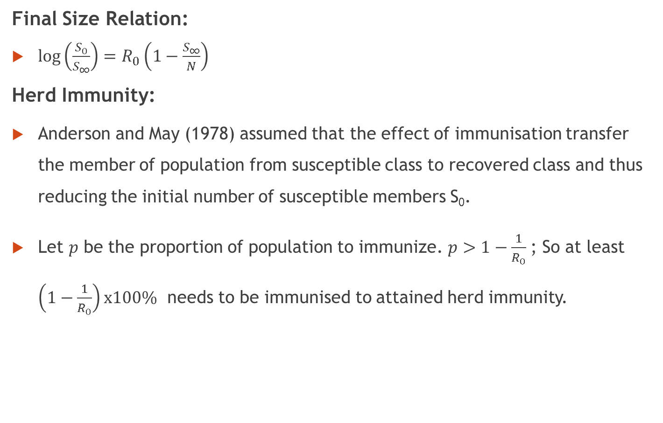
Final Size Relation:
$\log\left(\frac{S_{0}}{S_{∞}}\right)=R_{0}\left(1−\frac{S_{∞}}{N}\right)$
Herd Immunity:
Anderson and May (1978) assumed that the effect of immunisation transfer the member of population from susceptible class to recovered class and thus reducing the initial number of susceptible members S₀.
Let $p$ be the proportion of population to immunize. $p>1−\frac{1}{R_{0}}$ ; So at least $\left(1−\frac{1}{R_{0}}\right)x100\%$ needs to be immunised to attained herd immunity.

Slide 11
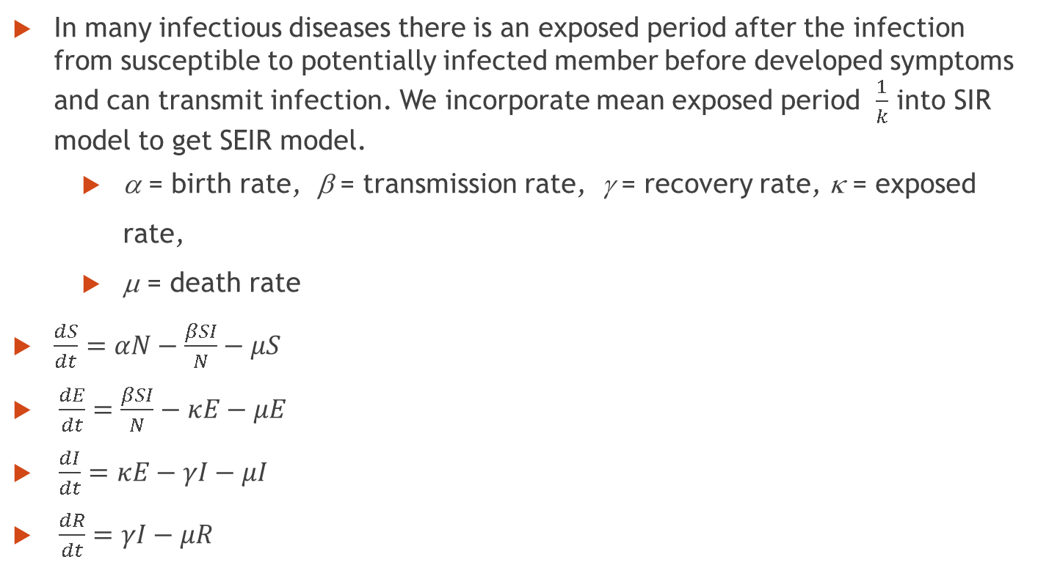
Susceptible Exposed Infective Recovered Model
In many infectious diseases there is an exposed period after the infection from susceptible to potentially infected member before developed symptoms and can transmit infection. We incorporate mean exposed period $\frac{1}{k}$ into SIR model to get SEIR model.
α = birth rate, β = transmission rate, γ = recovery rate, κ = exposed rate,
μ = death rate
$\frac{dS}{dt}=αN−\frac{βSI}{N}−μS$
$\frac{dE}{dt}=\frac{βSI}{N}−κE−μE$
$\frac{dI}{dt}=κE−γI−μI$
$\frac{dR}{dt}=γI−μR$

Slide 12

Basic Reproduction Rate(R₀):
$R_{0}=\frac{βκ}{\left(κ+μ\right)\left(γ+μ\right)}$

Slide 13
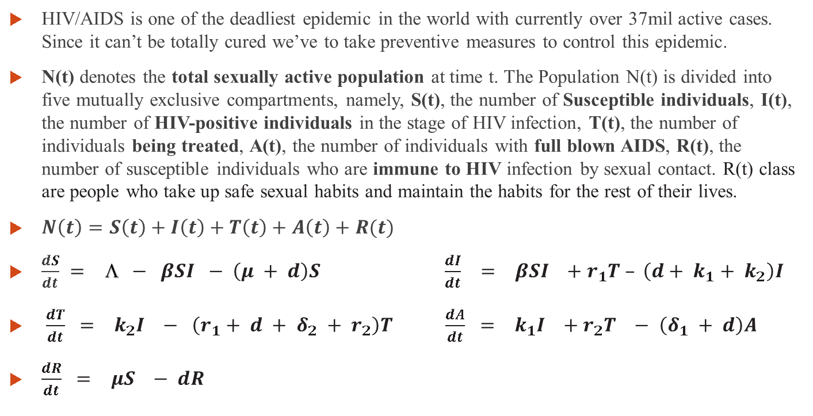
Deterministic Epidemic Modelling of HIV/AIDS
HIV/AIDS is one of the deadliest epidemic in the world with currently over 37mil active cases. Since it can’t be totally cured we’ve to take preventive measures to control this epidemic.
N(t) denotes the total sexually active population at time t. The Population N(t) is divided into five mutually exclusive compartments, namely, S(t), the number of Susceptible individuals, I(t), the number of HIV-positive individuals in the stage of HIV infection, T(t), the number of individuals being treated, A(t), the number of individuals with full blown AIDS, R(t), the number of susceptible individuals who are immune to HIV infection by sexual contact. R(t) class are people who take up safe sexual habits and maintain the habits for the rest of their lives.
$N\left(t\right)=S\left(t\right)+I\left(t\right)+T\left(t\right)+A\left(t\right)+R(t)$
$\frac{dS}{dt} = Λ − βSI − \left(μ + d\right)S \frac{dI}{dt} = βSI +r_{1}T – \left(d+ k_{1}+ k_{2}\right)I$
$\frac{dT}{dt} = k_{2}I − \left(r_{1}+ d + δ_{2} + r_{2}\right)T \frac{dA}{dt} = k_{1}I +r_{2}T − \left(δ_{1} + d\right)A$
$\frac{dR}{dt} = μS − dR$

Slide 14
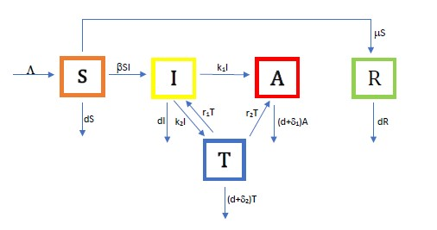

Slide 15
Parameters | Description
Λ | Recruitment rate of the population
β | Transmission coefficient of the infection stage
k₁ | Progression rate to A from I
k₂ | Progression rate to T from I
r₁ | Proportion of successful treatment
r₂ | Proportion of treatment failure
d | Natural death rate
μ | The rate of susceptible individuals who changed their habits
δ₁ | Disease-related death rate of the AIDS
δ₂ | Disease-related death rate of being treated

Slide 16
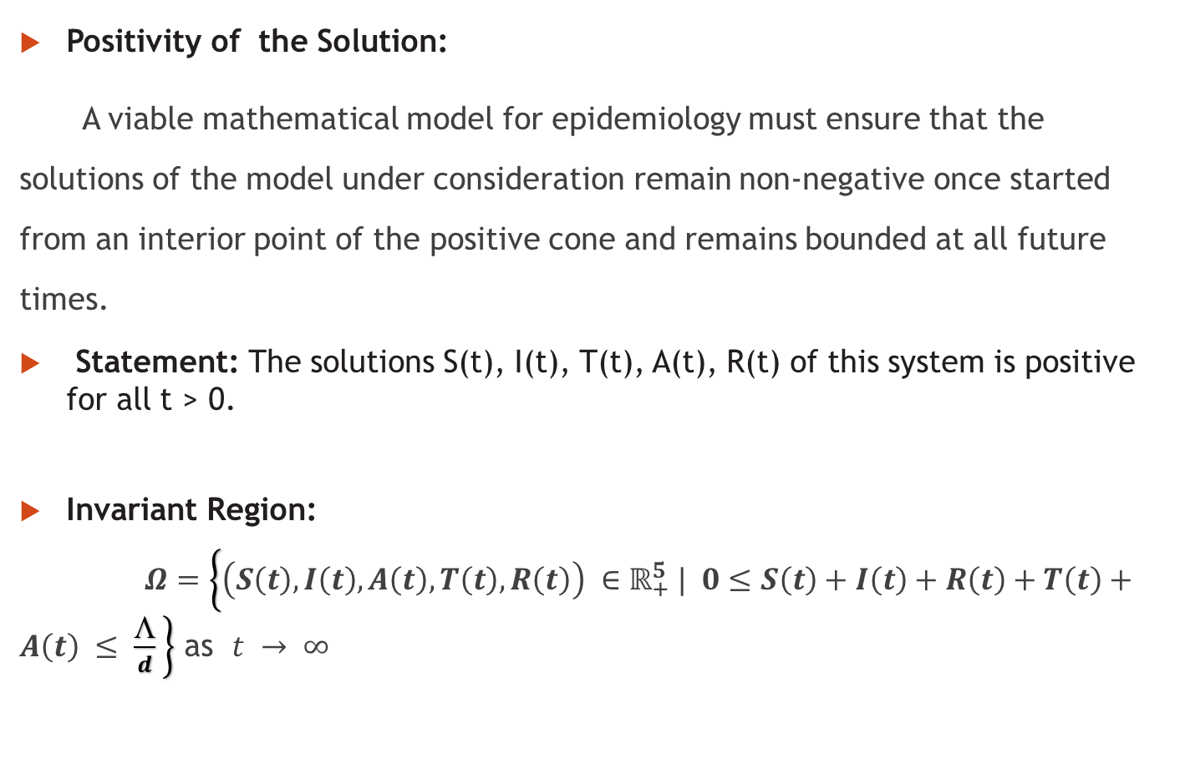
Positivity of the Solution:
A viable mathematical model for epidemiology must ensure that the solutions of the model under consideration remain non-negative once started from an interior point of the positive cone and remains bounded at all future times.
Statement: The solutions S(t), I(t), T(t), A(t), R(t) of this system is positive for all t > 0.
Invariant Region:
$Ω=\left\{\left(S\left(t\right), I\left(t\right), A\left(t\right), T\left(t\right), R\left(t\right)\right) ∈ℝ_{+}^{5} | 0≤S\left(t\right)+I\left(t\right)+R\left(t\right)+T\left(t\right)+A\left(t\right) ≤ \frac{☹}{d} \right\}$ as $t → ∞$

Slide 17
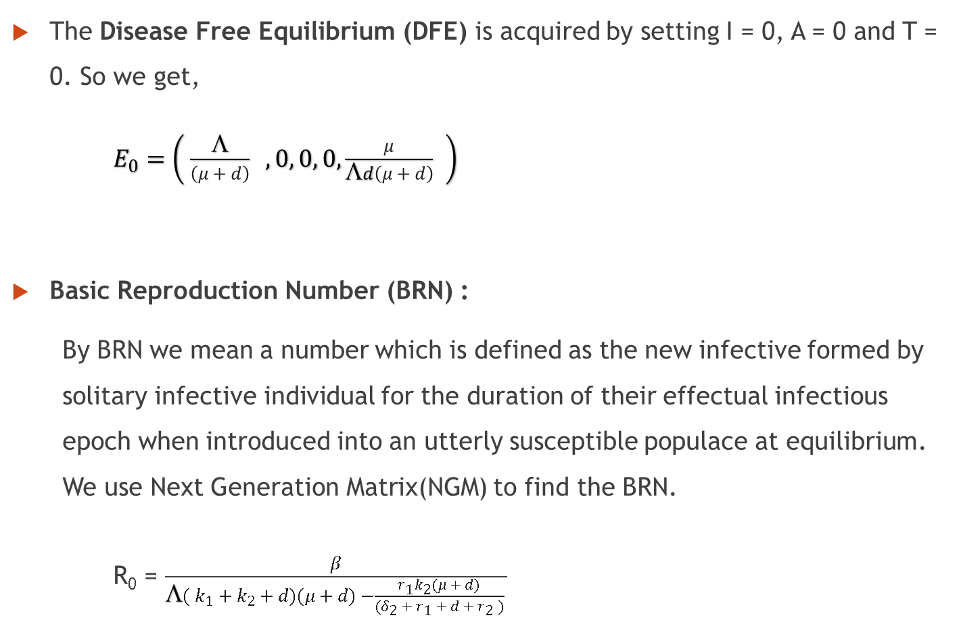
The Disease Free Equilibrium (DFE) is acquired by setting I = 0, A = 0 and T = 0. So we get,
$E_{0}=\left( \frac{Λ}{\left(μ + d\right)} , 0, 0, 0, \frac{μ}{Λd\left(μ + d\right)} \right)$
Basic Reproduction Number (BRN) :
By BRN we mean a number which is defined as the new infective formed by solitary infective individual for the duration of their effectual infectious epoch when introduced into an utterly susceptible populace at equilibrium. We use Next Generation Matrix(NGM) to find the BRN.
R₀ = $\frac{β}{Λ( k_{1} + k_{2} + d)(μ + d) −\frac{r_{1}k_{2}(μ + d)}{(δ_{2} + r_{1} + d + r_{2} )} }$

Slide 18
What is Next Generation Matrix?
In 1990, Diekmann and Hesterbeck introduced a method to find R₀ or Basic Reproductive Number (BRN) by using NGM which is now the most popular method. In population dynamics it is used to compute the Basic Reproduction Number for structured population models. It is also used in multi-type branching models for analogous computations.

Slide 19
Stability Analysis:
The sensitivity analysis for the endemic threshold (the controlled reproduction number R₀) tells us how important each parameter is to disease transmission. More precisely, sensitivity indices allow us to measure the relative change in a variable when a parameter changes.
Disease Free Equilibrium Statement:
The Disease-Free Equilibrium E₀ is locally asymptotically stable for R₀ < 1 and unstable for R₀ > 1.
The Disease-Free Equilibrium E₀ is globally asymptotically stable if R₀ <1.

Slide 20
Endemic Equilibrium Point, Statement:
If R₀ > 1, then the model has unique endemic equilibrium E*(S*,I*,A*,T*,R*)
If R₀ > 1, the endemic equilibrium E* of this model is globally asymptotically stable.

Slide 21
Numerical Simulations:
Parameters | Description | Values
Λ | Recruitment rate of the population | 0.61 year⁻¹
β | Transmission coefficient of the infection stage | 0.028 year⁻¹
k₁ | Progression rate to A from I | 0.15 year⁻¹
k₂ | Progression rate to T from I | 0.35 year⁻¹
r₁ | Proportion of successful treatment | Variable
r₂ | Proportion of treatment failure | Variable
d | Natural death rate | 0.0195 year⁻¹
μ | The rate of susceptible individuals who changed their habits | 0.055
δ₁ | Disease-related death rate of the AIDS | 0.0807 year⁻¹
δ₂ | Disease-related death rate of being treated | 0.0657 year⁻¹
Source: WHO ‘20

Slide 22
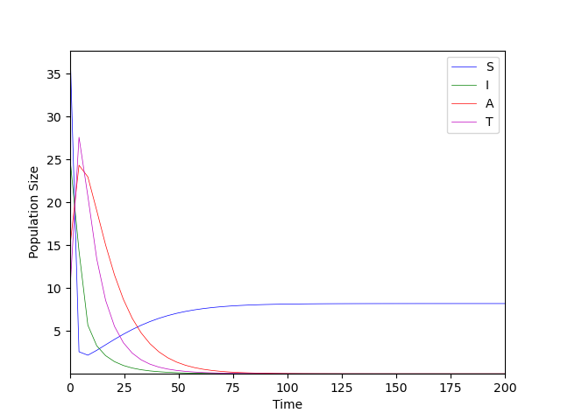
R₀ < 1,
DFE E₀ is
Globally Asymptotically Stable

Slide 23
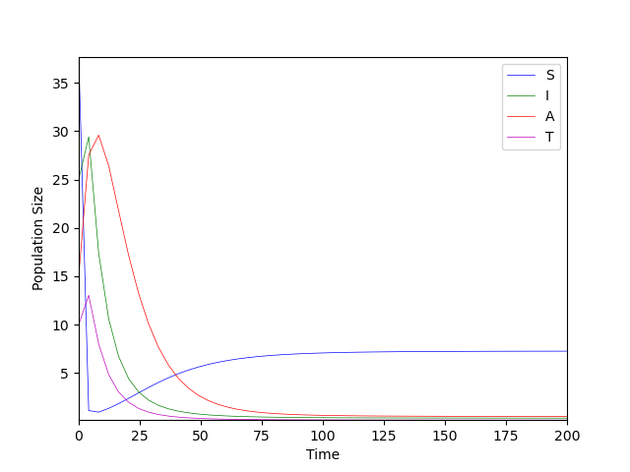
R₀ > 1
EEP E* is Globally Asymptotically Stable

Slide 24
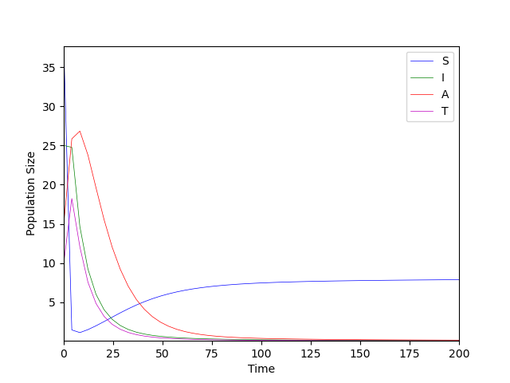
R₀ = 1
DFE E₀ is Globally Asymptotically Stable

Slide 25
Concluding Statement
We’ve constructed an Epidemic Model to figure out the most effective way to lower the incidence rate of the susceptible population. We’ve performed detailed numerical simulations of our proposed model. Our results show that we can control the disease by controlling the effective contact rate of the infected population. Also the early treatment of AIDS is necessary to reduce the threat on lives.
Though it may seem like the fit was more or less good with the actual data, the model has quite a few restrictions when working in the real life scenario. Since it’s dependent on the parameters, the accuracy changes depending on geography, climate season and many other factors. We’ve oversimplified a vague system here.

Slide 26
Now though there’re some restrictions for this model, it’s still quite useful to effectively lower the incidence rate and contain the epidemic call HIV/AIDS. If everyone takes proper step time to time then the infected number of populations will be differed from our predicted number as time progress, and we can surely decrease the infected persons and the victims. The public awareness is absolutely necessary to fight against the dangerous HIV/AIDS as per the proposed model.

Slide 27
Thank You!
Any Questions?
“I don’t know everything, I just know what I know”
- Tsubasa Hanekawa

